Slide 1
Inheritance

Slide 2
Objectives
Study concepts: superclass, subclass
Understand the “is-a” relationship
Functions in inheritance
Using an “instanceof” operator

Slide 3
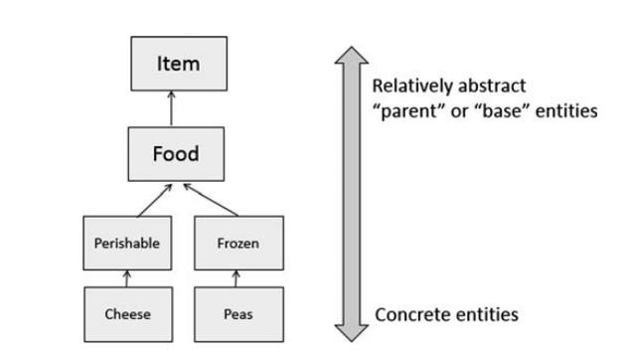
Derived and Super Classes
Object-oriented languages implement reusability of coding structure through inheritance
It refers to the relationship between classes where one class inherits the entire structure of another class
The root of our design is a relatively abstract entity, and we build upon that entity to produce progressively more concrete entities
the higher-level entities are “parent”, “base” or “super” classes
the lower-level ones built from them are “child”, "derived" or “sub” classes.

Slide 4
Implementing Object-Oriented Relationships
3 common relations in classes:
“is a/ a kind of”
“has a”
association
Examples:
Student is a person
“A home is a house that has a family and a pet.”
An invoice contains some products and a product can be contained in some invoices

Slide 5
Implementing Object-Oriented Relationships…
The relation “is a” is implemented as a sub-class
Person
String name, address String birthDate
+ String getName(); + void setName(String n);
…….
The relation “has a” is implemented as reference
Classes Professor, Student are sub-classes of the class Person
Sub-classes inherit the structure of super class
is a
is a
Professor
String department
+ String getDepartment(); + void setDepartment(String d);
Student
String studentId, majorField String degreeSought
+ String getStudentId(); + void setStudentID(String id)
….
teach
The class Professor has the field Student[] students
The class Student has the field Professor pr

Slide 6
Inheritance…
How to construct a class hierarchy? → Intersection
Rectangle< length, width>
Box < length, width, height>
Rectangle
Length width
Box
height

Slide 7
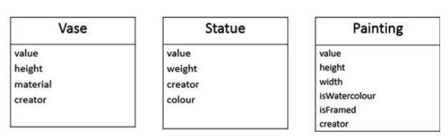
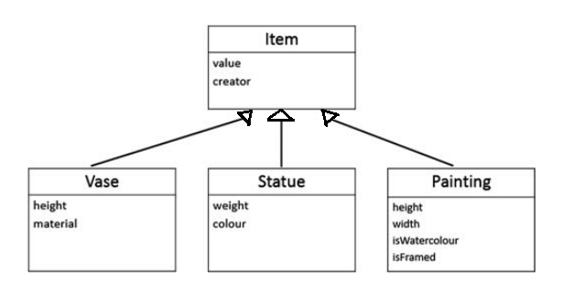
Inheritance…
How to construct a class hierarchy? → Intersection
Consider a shop that sells antiques items, namely vases, statues and paintings

Slide 8
Inheritance
There are some sub-classes from one super class ➔ An inheritance is a relationship where objects share a common structure: the structure of one object is a sub-structure of another object.
The extends keyword is used to create sub-class.
A class can be directly derived from only one class ( Java is a single-inherited OOP language).
If a class does not have any superclass, then it is implicitly derived from Object class.
Unlike other members, constructor cannot be inherited ( constructor of super class can not initialize sub-class objects)

Slide 9
“super” Keyword
Constructors Are Not Inherited
super(...) for Constructor Reuse
super(arguments); //invoke a superclass constructor
Subclass constructor must invoke super class constructor
The call must be the first statement in the subclass constructor
Note: If a constructor does not explicitly invoke a superclass constructor, the Java compiler automatically inserts a call to the no-argument constructor of the superclass. If the super class does not have a no-argument constructor, you will get a compile-time error.

Slide 10
Functions in inheritance
A derived class inherits from superclass is limited to the normal member functions of the superclass.
We use the Java keyword super as the qualifier for calling a superclass ’s method:
super.methodName(arguments);
To invoke the version of method methodName that was defined by our superclass.
Hiding a method: Re-implementing a static method implemented in super class

Slide 11
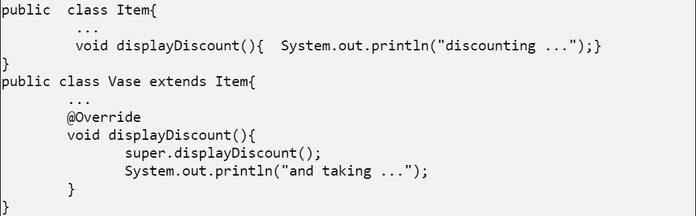
Functions in inheritance
Output:
discounting …
and taking …
The "displayDiscount" method has the same signature (name, plus the number and the type of its parameters) and return type as in the superclass. It is called overriding the superclass's method=> We will learn override method in the next topic
The "displayDiscount") that was defined by our superclass. We use the "super" keyword

Slide 12
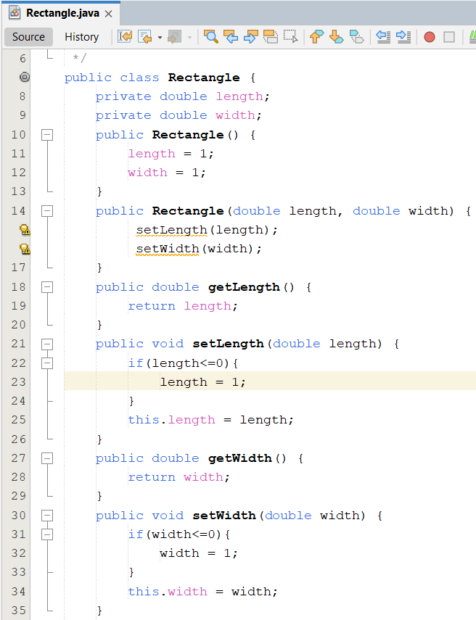
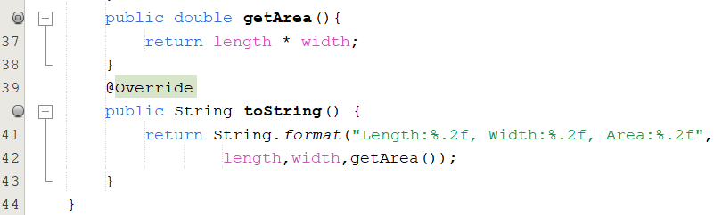
Inheritance…

Slide 13
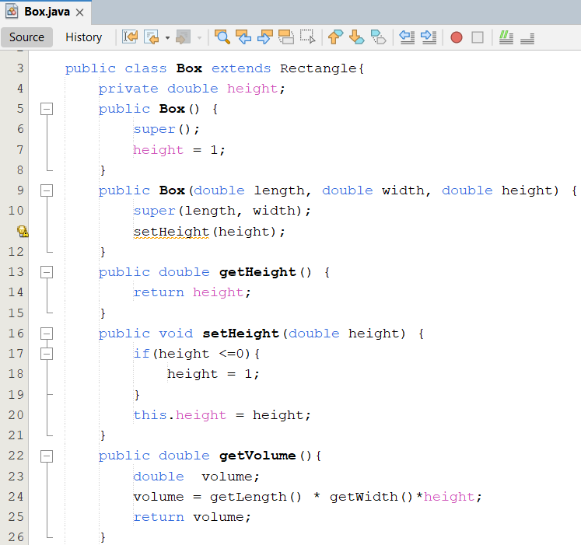
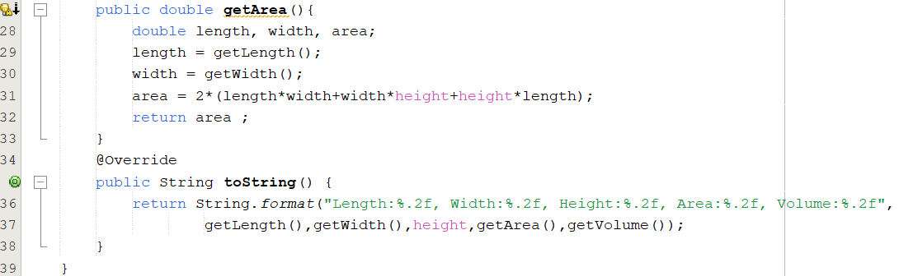
Inheritance…

Slide 14
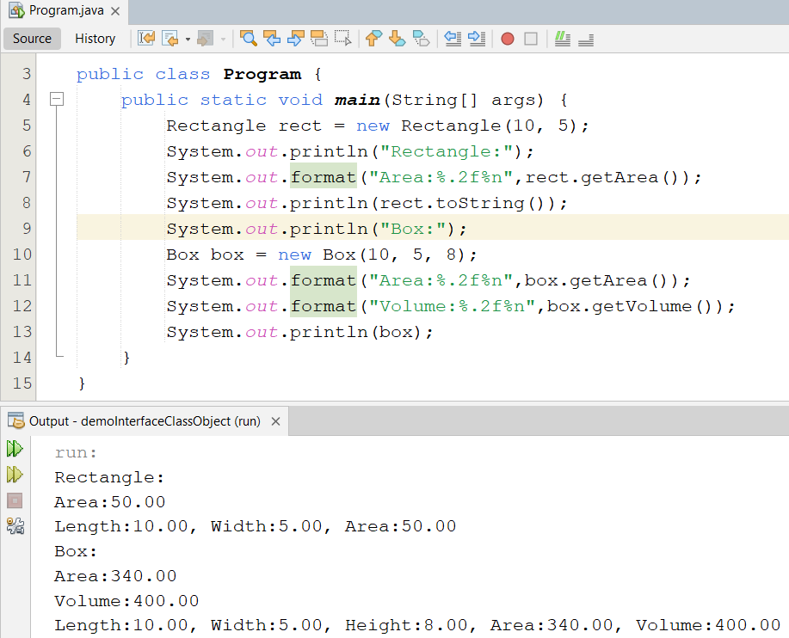
Inheritance…

Slide 15
Overriding and Hiding Methods (1)
Overriding a method: An instance method in a subclass with the same signature (name, plus the number and the type of its parameters) and return type as an instance method in the superclass overrides the superclass's method.
Use the @Override annotation that instructs the compiler that you intend to override a method in the superclass (you may not use it because overriding is the default in Java).
Hiding a method: Re-implementing a static method implemented in super class

Slide 16
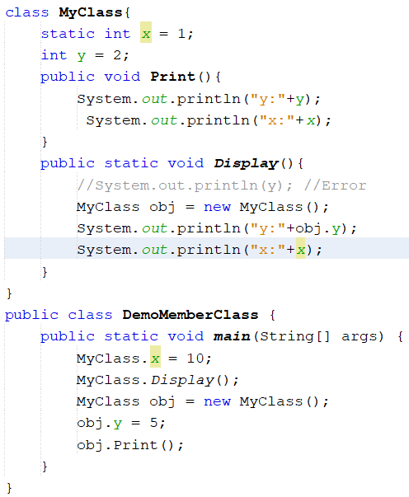

Static Example

Slide 17
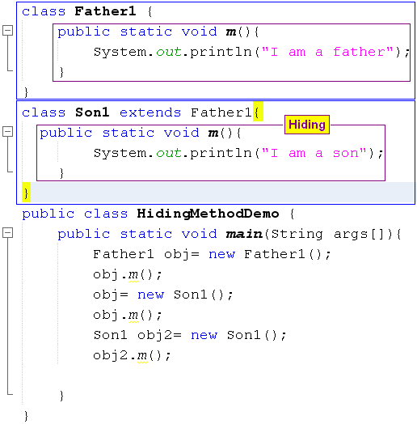

Hiding Methods

Slide 18
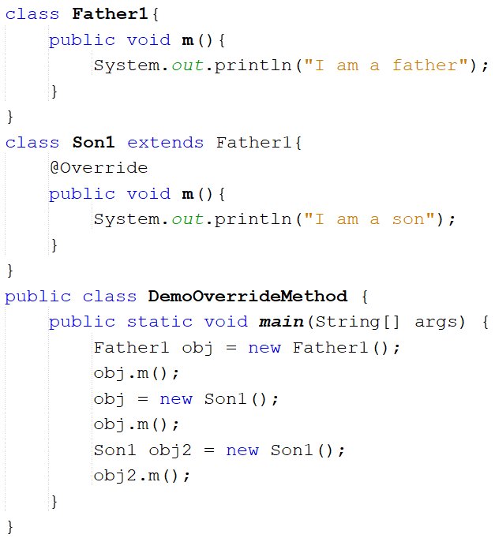

Overriding Methods

Slide 19
Using an “instanceof” operator
Dynamic and Static type
dynamic type: A reference variable that has the type of the superclass can store the address of the object of sub class. It is called to be dynamic type, the type that is has at runtime. Rectangle obj1 = new Box();
Static type: The type that it has when first declared. Static type checking is enforced by the compiler. Box obj2 = new Box();
“Instanceof” operator: It checks whether the reference of an object belongs to the provided type or not, the instanceof operator will return true or false. If ( obj1 instanceof Box) System.out.println(“ obj1 is pointing to the Box object”);

Slide 20
Casting
A variable that has the type of the superclass only calls methods of the superclass. To call methods of the subclass we must cast explicitly
for example,
public void Run(Rectangle obj){
if( obj instanceof Box ) { ((Box)obj).setHeight(300);
}
}
//-----------------------------------
Box obj = new Box();
Run(obj);

Slide 21
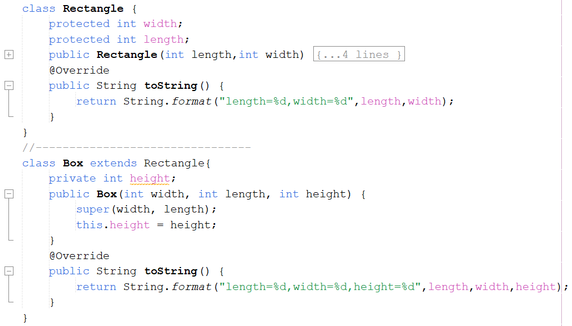
Demo Casting

Slide 22
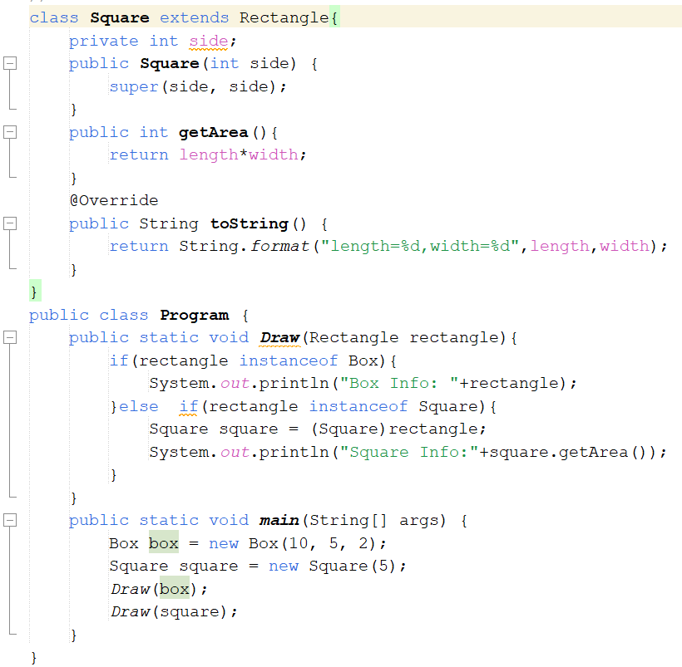
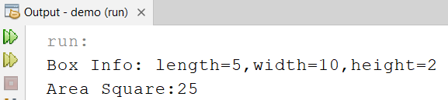
Demo Casting

Slide 23

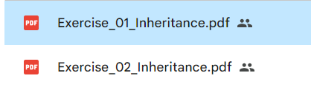
Exercise

Slide 24
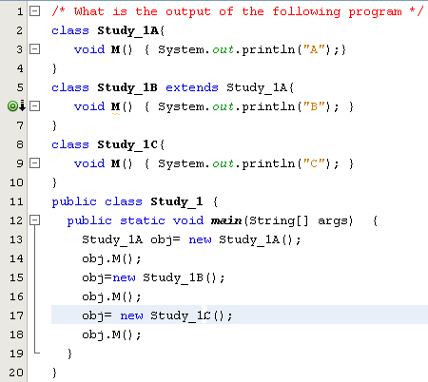
Test
a) ABC
b) AAC
c) ABA
d) Compile-time error
Study_1A and Study_1C are inconvertible

Slide 25
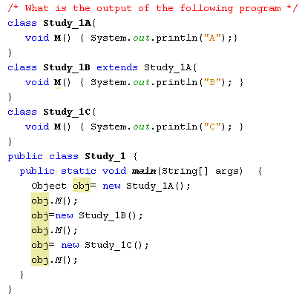
Test
a) ABC
b) AAC
c) ABA
d) Compile-time error
The java.lang.Object class does not have the M() method

Slide 26
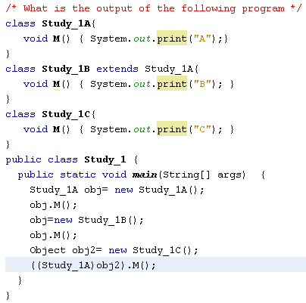
Test
a) ABC
b) AAA
c) ABA
d) None of the others
AB and a ClassCastException

Slide 27
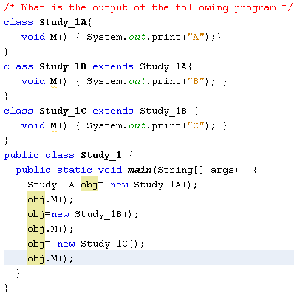
Test
a) AAA
b) ACB
c) None of the others
d) ABC

Slide 28
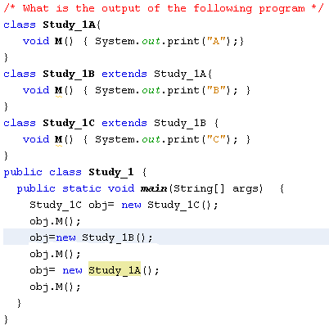
Test
a) ABC
b) AAA
c) ABA
d) None of the others
Compile-time error
( Type conformity violation)

Slide 29
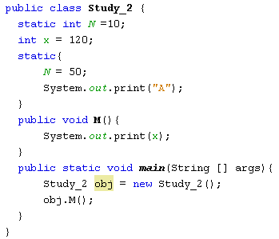
Test
a) 120
b) 120A
c) None of the others
d) A120

Slide 30
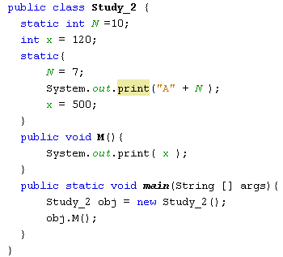
Test
a) A7500
b) 500A7
c) 500
d) None of the others
Compile-time error
( static code can not access instance variables)

Slide 31
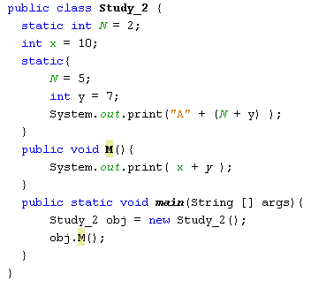
Test
a) A1210
b) 10A12
c) 17
d) None of the others
Compile-time error
( The y variable is out of scope)

Slide 32
Summary
Object-oriented languages implement reusability of coding structure through inheritance
A derived class does not by default inherit the constructor of a super class
Constructors in an inheritance hierarchy execute in order from the super class to the derived class
Using the instanceof keyword if we need to check the type of the reference variable.
Check the type of the reference variable before casting it explicitly.

